Slide 1
Chapter 3 Crawls and Feeds
SEG301m

Slide 2
Objectives
How to crawl webs or documents?
Techniques to preprocess documents: encoding, remove noise, delete duplicates

Slide 3
Contents
3.1 What to search?
3.2 Crawling the Web
3.3 Crawling documents and emails
3.4 Documents feeds
3.5 Conversion problem: character encodings
3.6 Storing documents
3.7 Delete duplicates
3.8 Remove noise

Slide 4
3.1 What to search?
Everything you possibly can!
Every document answers at least one question
The best documents answer many more
Is “Search engine adds another document” good or not?
the number of questions it can answer increases
not easy to find the best documents to show to the user
Notes:
search engine adds another document, the number of questions it can answer increases
adding many poor-quality documents increases the burden on the ranking process to find only the best documents to show to the user

Slide 5
3.2 Crawling the Web
Build a search engine that searches web pages → need the content of web pages → copy web pages
Finding and downloading web pages: crawling, the program downloads pages: web crawler
Challenges in copying pages?
the sheer scale of the Web: at least tens of billions of pages on the Internet and constantly created
web pages are usually not under the control of the people building the search engine database

Slide 6
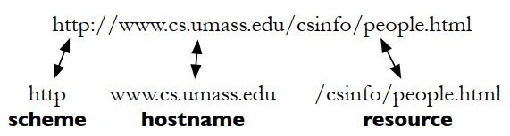
3.2 Crawling the Web: retrieving Web pages
Each web page has unique uniform resource locator (URL)
Scheme’s resource retrieved using http
Name of the computer running web server
Specific page in the computer

Slide 7
3.2 Crawling the Web: retrieving Web pages
The most common HTTP request type is GET request:
→ asks server to send the page called /csinfo/people.html
Other request is POST request: similar to GET request but sending additional information to the server → click a button to buy something or to edit a web page

Slide 8
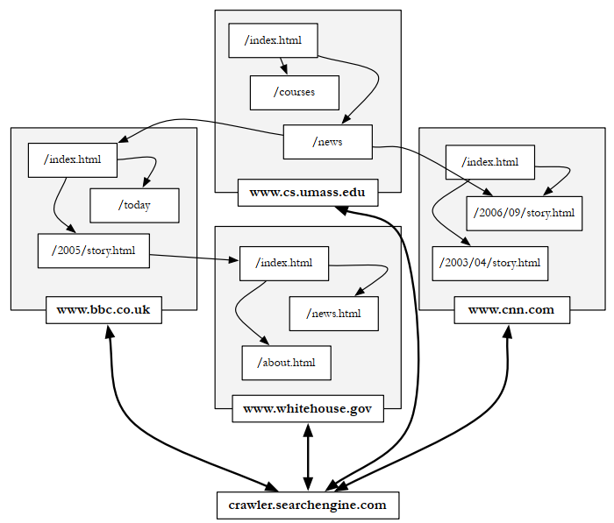
3.2 Crawling the Web: the Web Crawler
The web crawler connects to web servers to find pages. Pages may link to other pages on the same server or on different servers

Slide 9
3.2 Crawling the Web: the Web Crawler
Frontier: request queue that is used to store new URL that the crawler has not seen it before.
Why should a crawler use multiple threads?
waits for the web page data to be sent from the serve
waits for the DNS server response
waits for the connection to the web server to be acknowledged

Slide 10
3.2 Crawling the Web: the Web Crawler
Problem: When a web page is fetched, it is parsed and all of the links on that page are added to the request queue
politeness policies:
Reasonable web crawlers do not fetch more than one page at a time from a particular web server
Web crawlers wait at least a few seconds, and sometimes minutes, between requests to the same web server
Request queue is logically split into a single queue per web server

Slide 11
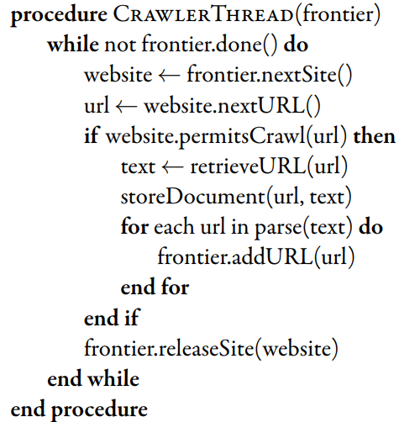
3.2 Crawling the Web: the Web Crawler
A simple crawling thread implementation
Notes:
Pseudo code

Slide 12
3.2 Crawling the Web: Freshness
Why does web crawler need to revisit pages it has already crawled?
Web pages are constantly being added, deleted, and modified
To see if they have changed in order to maintain the freshness of the document collection

Slide 13
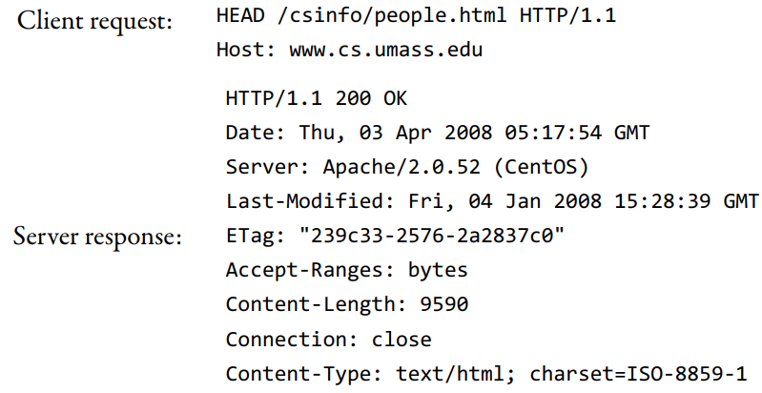
3.2 Crawling the Web: Freshness
Check for page changes: using HTTP protocol because it has a special request type called HEAD
the last time the page content was changed

Slide 14
Exercise
Use a special request type called HEAD to check the last time the page content was change.

Slide 15
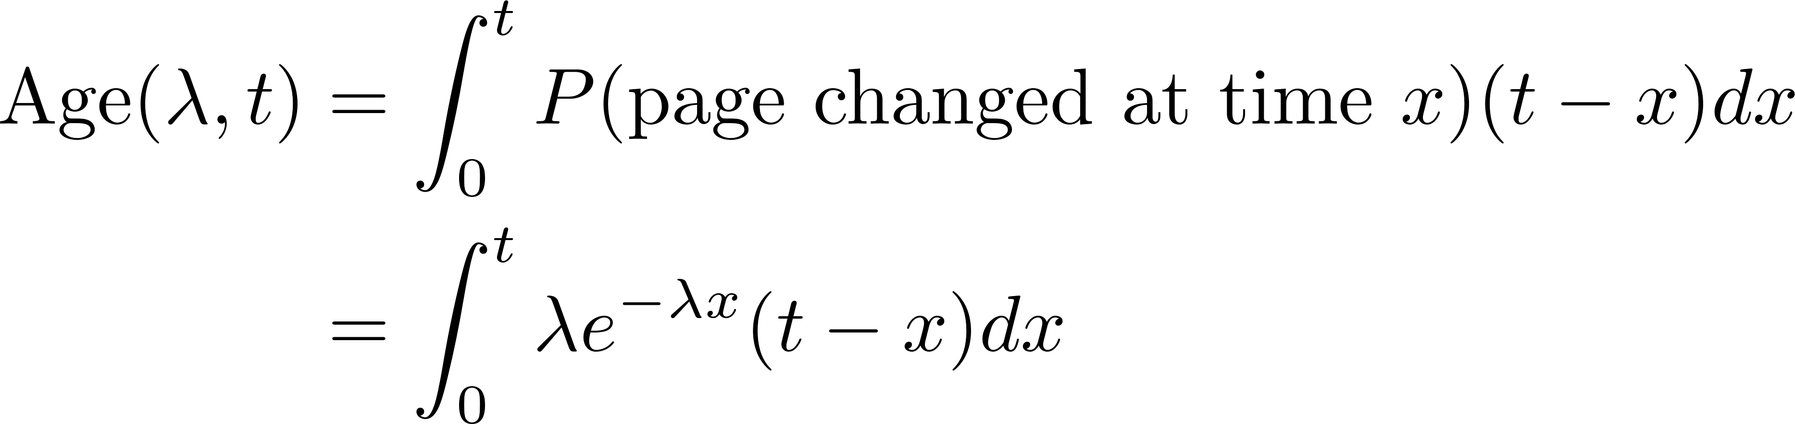
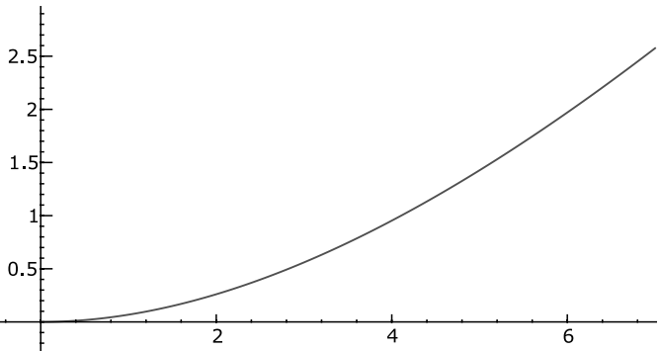
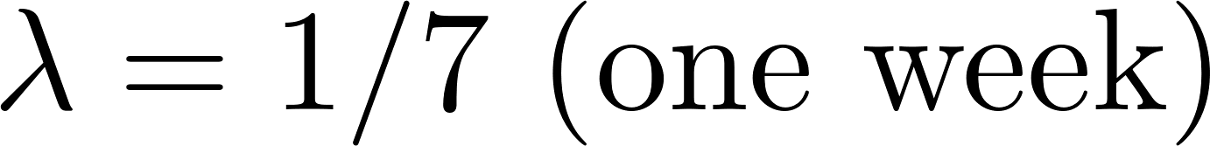
3.2 Crawling the Web: Freshness
Metric to be used to optimize crawlers: Age
Notes:
the second derivative of the Age function is always positive

Slide 16
3.2 Crawling the Web: Focused Crawling
Focus on a specific topic of information
Movie -> search engine can lead to more information about movies
Accuracy(vertical search) > Accuracy(general search): because lack of extraneous information in the document collection
Method 1: crawl a full copy of the Web and then throw out all unrelated pages
Disadvantage: huge amount of disk space and bandwidth
Most of the web pages will be discarded at the end
Method 2: focused crawling -> requires some automatic means for determining whether a page is about a particular topic

Slide 17
3.2 Crawling the Web: Deep Web
Deep Web (hidden Web): difficult to find
Private sites
Form results
Scripted pages

Slide 18
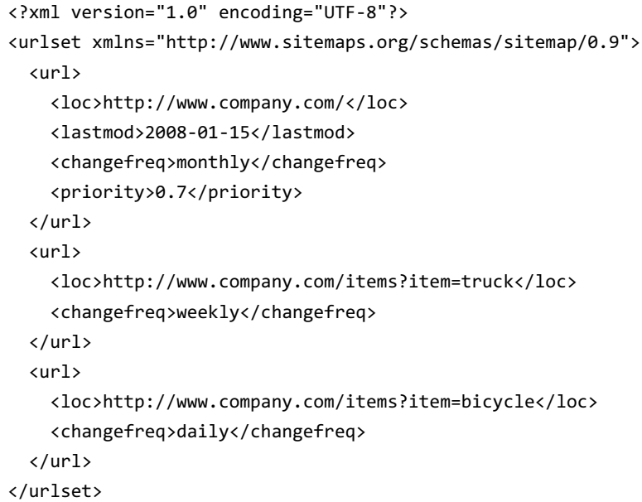
3.2 Crawling the Web: Sitemaps
Problem: site owners cannot adequately tell crawlers about their sites
URL
Modification time
Modification frequency

Slide 19
3.3 Crawling documents and emails
Where to store email, word processing documents, presentation or spreadsheets? -> Desktop/Laptop computer
Is it challenged as crawling desktop data?
Update speed
Disk space
Requirement of a focus on data privacy
Notes:
Update speed: search for an email the instant it is received, and being able to search for a document as soon as it has been saved disk space: A desktop crawler instead may need to read documents into memory and send them directly to the indexer.

Slide 20
3.4 Documents feeds
Definition: a document sequence in which published documents afrom a single source can be ordered
Two kinds of document feeds: push and pull
Push: alerts the subscribers to new documents
RSS: Really Simple Syndication, RDF Site Summary, or Rich Site Summary
Pull: requires subscribers to check periodically for new documents

Slide 21
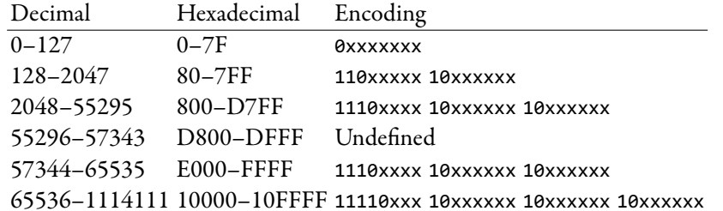
3.5 Conversion problem: character encodings
Text on pages is a series of little pictures called letters or glyphs
Character encoding is a mapping between bits and glyphs
ASCII: 1-byte standard
CJK (Chinese-Japanese-Korean): 2-byte standard

Slide 22
3.6 Storing documents
Documents converted to some common format: need to be stored in preparation for indexing
Simplest document storage is no document storage
Basic requirements
Random access
Compression
Updating
Benefits of using a database system or a customized storage system
Notes:
In desktop search, for example, the documents are already stored in the fle system and do not need to be copied elsewhere

Slide 23
3.6 Storing documents: using a Database System
A database takes care of the difficult details of storing small pieces of data
Most databases also run as a network server, so that the documents are easily available on the network
Databases also tend to come with useful import and analysis tools
Notes:
In desktop search, for example, the documents are already stored in the fle system and do not need to be copied elsewhere

Slide 24
3.6 Storing documents: Random Access
To retrieve documents quickly in order to compute a snippet for a search result: random access
Data store such that we can request the content of a document based on its URL
Easiest way to handle this kind of lookup is with hashing
Notes:
In desktop search, for example, the documents are already stored in the fle system and do not need to be copied elsewhere

Slide 25
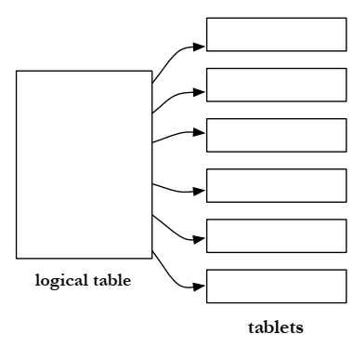
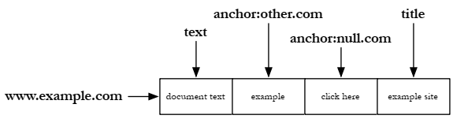
3.6 Storing documents: BigTable
Very largest document collections demand custom document storage systems
The table is split into small pieces, called tablets, which are served by thousands of machines
No query language: no complex queries -> row-level transactions

Slide 26

3.7 Delete duplicates: duplicate
The use of multiple URLs to point to the same web page and mirror sites can cause a crawler to generate large numbers of duplicate pages
Detecting exact duplicates is a relatively simple task that can be done using checksumming techniques.
Based on the content of the document
Any document file containing the same text would have the same checksum!

Slide 27

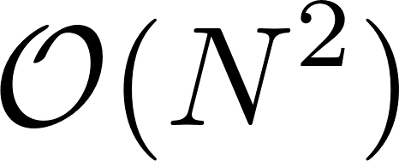
3.7 Delete duplicates: nearly duplicate
Near-duplicate documents: more difficult to detect
Web: same content but differ in the advertisements, dates or formatting
Use threshold to define a near-duplicate document
90% of the words in the documents are the same
Two scenarios for near-duplicate detection
Search scenario:
Discovery scenario
Notes:
N documents

Slide 28
3.7 Delete duplicates: fingerprints
The basic process of generating fingerprints:
The document is parsed into words. Non-word content, such as punctuation, HTML tags, and additional whitespace, is removed (see section 4.3).
The words are grouped into contiguous n-grams for some n. These are usually overlapping sequences of words (see section 4.3.5), although some techniques use non-overlapping sequences.
Some of the n-grams are selected to represent the document.
The selected n-grams are hashed to improve retrieval efficiency and further reduce the size of the representation.
The hash values are stored, typically in an inverted index
Notes:
N documents

Slide 29
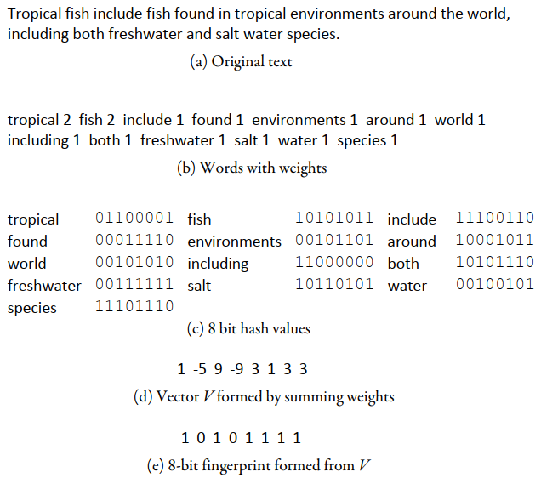
3.7 Delete duplicates: fingerprints
Example:

Slide 30
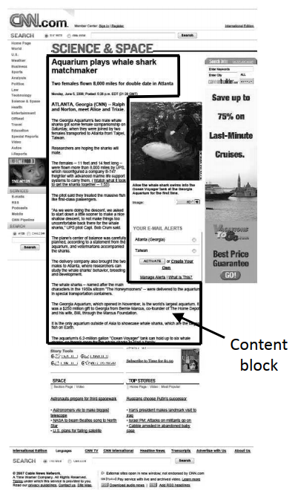
3.8 Remove noise
Content block takes up less than 20% of the display area of the page
Banners
Advertisements
Images
General navigation links
services
Noise

Slide 31
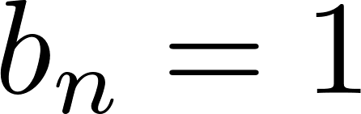
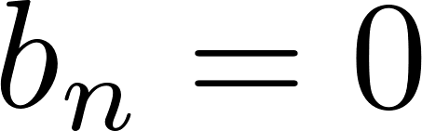
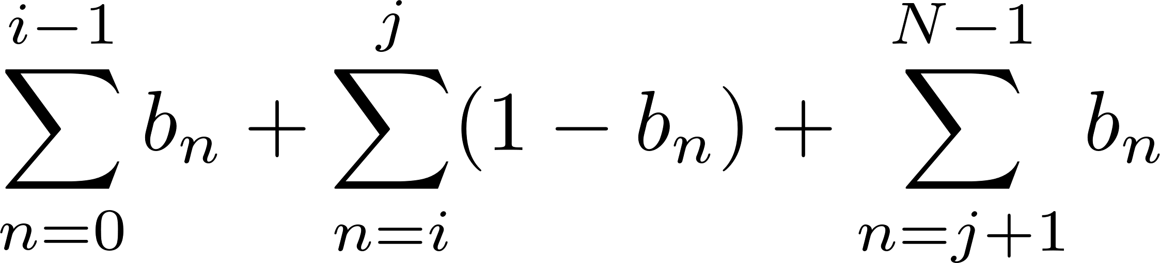
3.8 Remove noise
One way to detect the largest ﬂat area of the distribution is to represent a web page as a sequence of bits
indicates that the nth token is a tag, and otherwise
Find values of i and j to maximize both the number of tags below i and above j and the number of non-tag tokens between i and j
where N is the number of tokens in the pages.

Slide 32
Exercise
Implement the above algorithm (crawlerThread) to crawl any website.

Slide 33
Summary
Crawl webs, documents and emails
Character encoding
Preprocess: delete duplicates and remove noise

